Slide 1

Student Management System
Hassan Hosny

Slide 2
Introduction
The Student Management System is a Java-based application designed to efficiently manage student information.
It provides a robust graphical user interface (GUI) for various tasks related to student management.

Slide 3
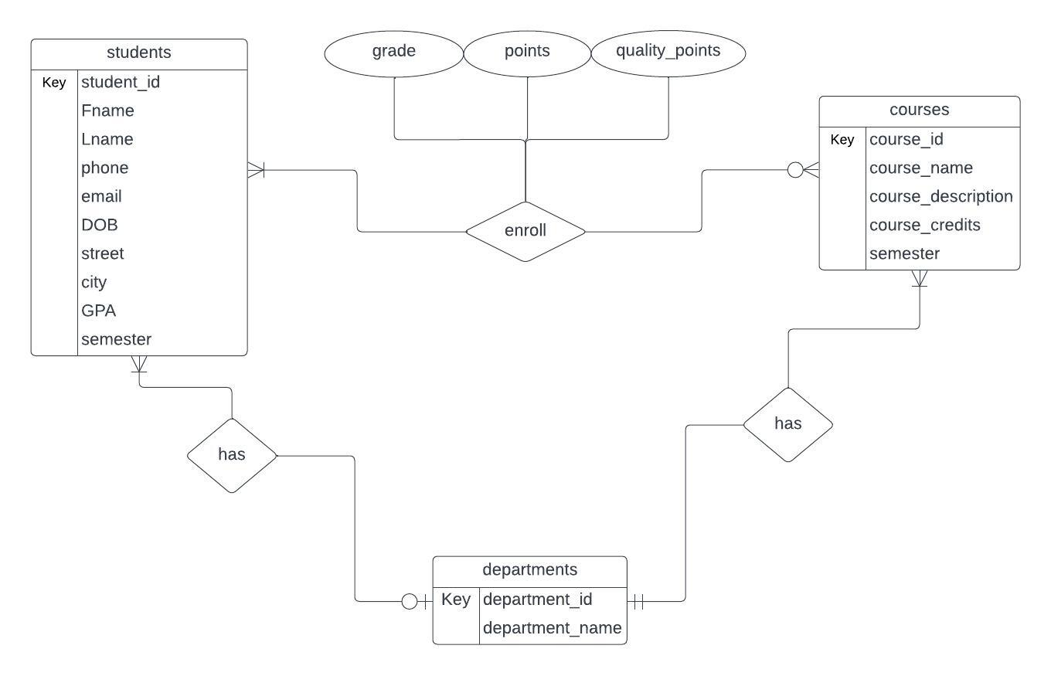
Database Design
ERD: Entity-Relationship Diagram showcasing the relationships between tables.
Database schema: Mapping of tables and their attributes.

Slide 4
Relationships
Student
Belongs to one Department, Enrolls in many Courses.
Course
Offered by one Department, Has many Students.
Department
Offers many Courses, Has many Students.

Slide 5
Mapping & tables & SQL implementation
Departments Table
Columns: ID (NUMBER, PK), Name (VARCHAR)
Constraints: PK (Uniqueness), NOT NULL (Name always provided)
Students Table
Columns: ID (NUMBER, PK), First Name (VARCHAR), Last Name (VARCHAR), Phone (VARCHAR), Email (VARCHAR), DOB (DATE), Street (VARCHAR), City (VARCHAR), GPA (DECIMAL), Dept_ID (NUMBER, FK), Semester (NUMBER)
Constraints: PK (Uniqueness), FK (Valid Dept_ID)

Slide 6
Cont.
Courses Table
Columns: ID (NUMBER, PK), Name (VARCHAR), Description (VARCHAR), Dept_ID (NUMBER, FK), Credits (NUMBER), Semester (NUMBER)
Constraints: PK (Uniqueness), FK (Valid Dept_ID)
Enroll Table
Columns: Student_ID (NUMBER, FK), Course_ID (NUMBER, FK), Grade (VARCHAR), Points (NUMBER), Quality_Points (DECIMAL)
Constraints: Composite PK (Student_ID, Course_ID), FK (Valid Student_ID, Course_ID)

Slide 7
PLSQL Implementation
CALCULATE_POINTS_QUALITY TRIGGER
The trigger automates the calculation of points and quality points for a student's grade in a course.
UPDATE_GPA_TRIGGER
The trigger makes sure that when enrollments change, the students' GPAs get recalculated and updated in the STUDENTS table.

Slide 8
Cont.
ON_COURSE_DELETE TRIGGER
The trigger makes sure that deleting a course also removes all its enrollments in the ENROLL table.
ON_DEPARTMENT_DELETE TRIGGER
The trigger ensures that deleting a department automatically removes all linked courses and students from the COURSES and STUDENTS tables.
ON_STUDENT_DELETE TRIGGER
The trigger makes sure that deleting a student also removes all their enrollments in the ENROLL table automatically.

Slide 9
Automation Scripts
Database Backup.
Prepare the database, make folders, save a time-stamped backup using a command, and note if it worked in a log file.
Disk Space Monitoring.
Set a disk usage limit, check disk usage with df -h, compare it to the limit, show a warning if it's too high, and log the status with a timestamp.
Task scheduling.
Using task scheduler in windows.

Slide 10
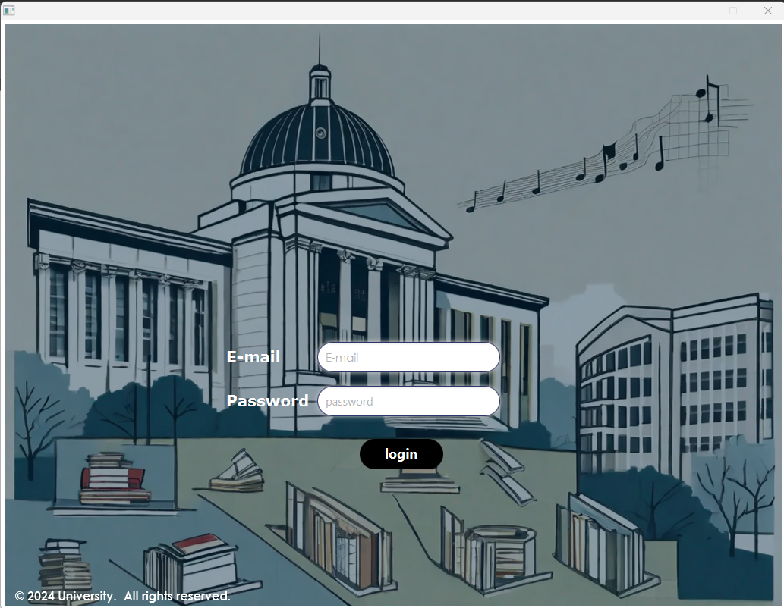
Java Application Development
Login page

Slide 11
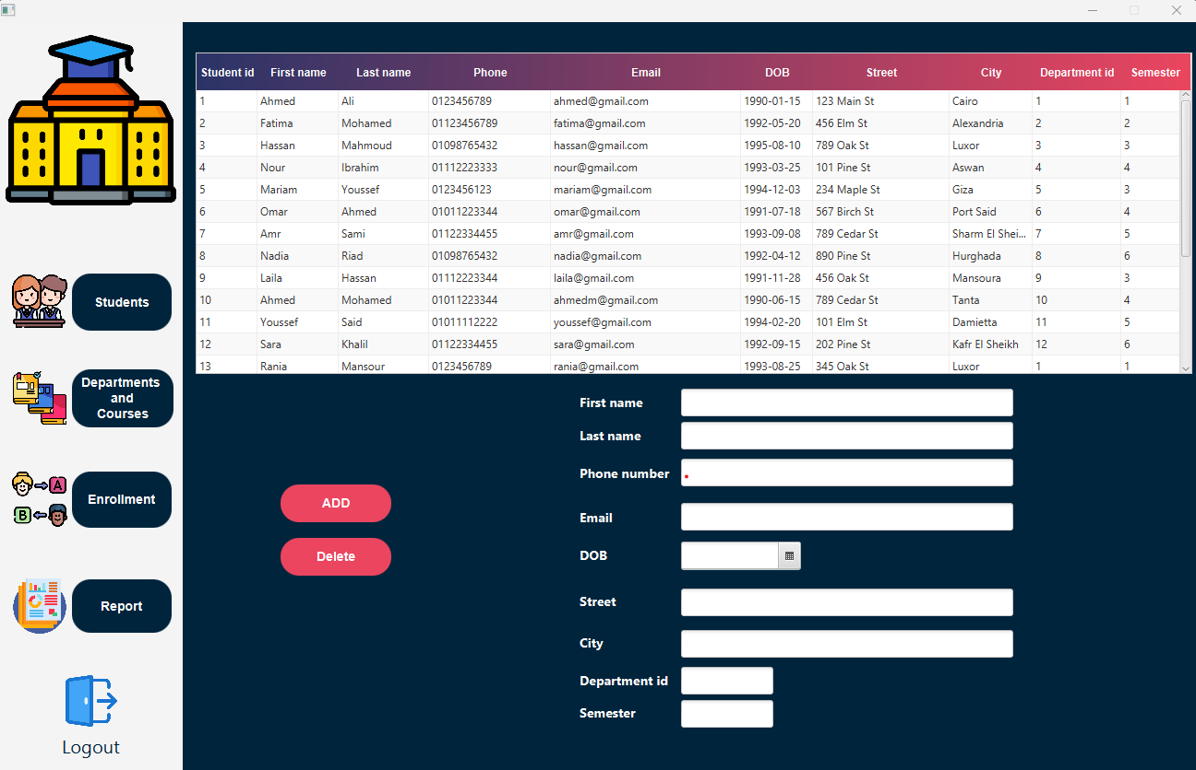
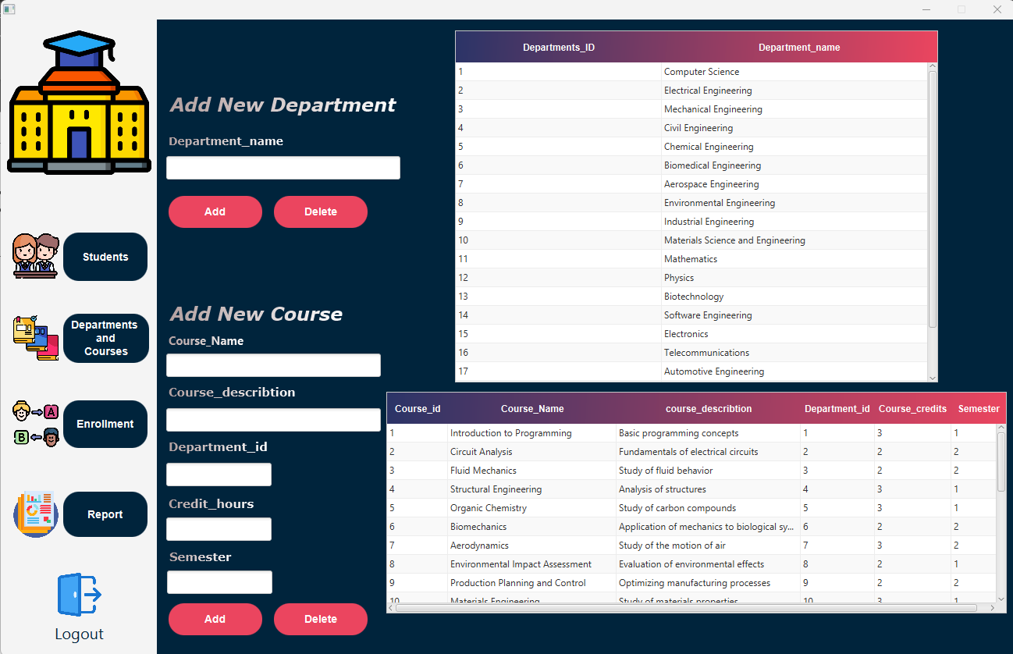
Cont.
Students and Departments_Courses page

Slide 12
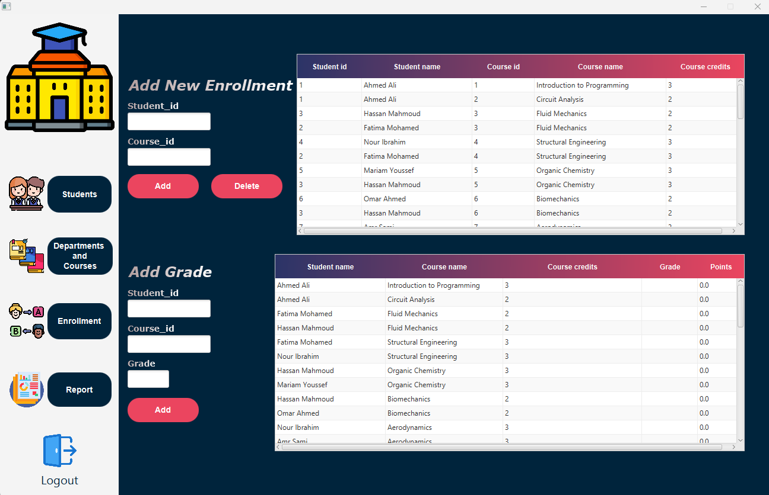
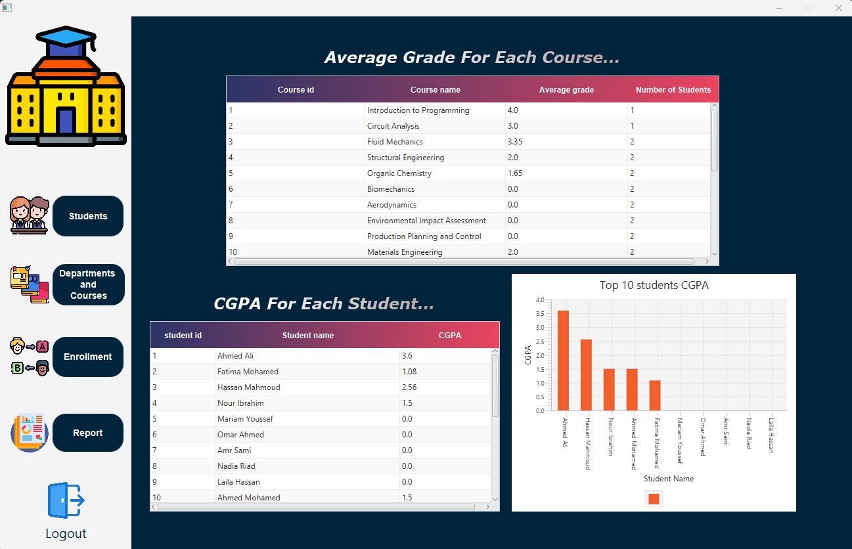
Cont.
Enrollment and Report

Slide 13


